Slide 1
Exploring
Large Language Models for
Argument Relation Identification
Notes:
Good day, everyone. Today, I'll be presenting my thesis on the application of large language models for argument relation identification in the financial domain. We will explore how these advanced AI models can significantly enhance our understanding and processing of complex financial texts.

Slide 2
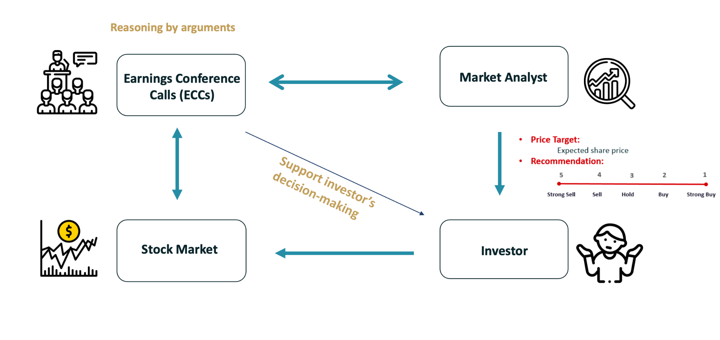
Motivation
By Alaa Alhamzeh
Notes:
Our journey begins with understanding the core motivation behind this study. Analysts and investors rely heavily on earnings conference calls to make informed decisions. These calls contain nuanced arguments that, when correctly analyzed, can reveal deep insights into a company's future. My research aims to leverage LLMs to better capture and analyze these arguments.

Slide 3
Argument Mining Overview
Segmentation
Augment/Non-Augment
Identifying Argument Components
Intrinsic
E.g. is X evidence?
Contextual
E.g. is X a premise?
Complexity Increases
Identifying Clausal Properties
Our Interest
General Relations
E.g. Are premis X and Claim Y Related?
Identifying Relational Properties
Argumentative Assessment
E.g. Is argument X strong Argument from Expert Opinion?
John Lawrence, Chris Reed; Argument Mining: A Survey. Computational Linguistics 2019; 45 (4): 765–818. doi: https://doi.org/10.1162/coli_a_00364
Notes:
Let's delve into what argument mining entails. It starts with segmenting texts to isolate argumentative components, followed by identifying and analyzing the structure and clausal properties of these arguments. Understanding these components allows us to assess the quality of arguments more effectively.
Our primary interest lies in general relation assessment, where we analyze the connections between different argument components, such as premises and claims since this problem is rarely investigated in the literature. Finally, argumentative quality assessment evaluates the overall strength and validity of these arguments.
As we move from top to bottom, the complexity of these tasks increases.
In wrapping up our overview of argument mining, this foundational knowledge is critical as we explore how arguments are structured and assessed for quality and validity in various contexts, particularly in financial texts. Now, let's broaden our perspective and examine how other researchers have approached argument mining. We'll look at the evolution of methodologies and how they've impacted the effectiveness of argument analysis.

Slide 4
Related Work
Table1: Summary of related work of argument mining from 2019 until now in different argument mining tasks
Section | Reference | Task | Methods | Results
Classical ML | Segura-Tinoco et al 2023 | Dimensionality Reduction for Machine Learning-based Argument Mining | SVD, PCA, and LDA for dimensionality reduction for different argument mining tasks | 72% F1-score
 | Solmsdorf et al 2021 | Active Learning for Argument Mining: A Practical Approach | Active Learning to reduce annotation effort for Argument Unit Recognition and Classification | 61% F1-score
Neural Networks | Bouslama et al 2019 | Using Convolutional Neural Network in Cross-Domain Argumentation Mining Framework | CNNs for Argument Component Detection | 75% Accuracy
 | Xiong et al 2021 | Research on the Classification of Argument Components Based on BiLSTM-ATT-CNN-CRF | BiLSTM-ATT-CNN-CRF model for Argument Components Classification | 79% Accuracy
 | Galassi et al 2021 | Deep Networks and Knowledge: from Rule Learning to Neural-Symbolic Argument Mining | Logic Tensor Networks. | 88% F1-score
 | Arymurthy et al 2019 | Attention-based argumentation mining | XGBoost and attention mechanism. | 83% F1-score
LLMs | Al Zubaer et al 2023 | Performance analysis of large language models in the domain of legal argument mining | GPT-4 Argument Clause Classification | 79% F1-score
 | Chen et al 2023 | Exploring the Potential of Large Language Models in Computational Argumentation | GPT-3.5 Turbo Claim Detection | 72% F1-score
Notes:
This slide summarizes key advancements in argument mining, categorized by approaches ranging from Classical Machine Learning to Neural Networks. Each study has contributed to our understanding of argument analysis with varying degrees of success, noted from F1 scores ranging from 61% to 88%. However, it's important to note that most of these studies rely on simple evaluation strategy such as train-test split on small datasets, This common approach can sometimes obscure the real-world effectiveness of these methods, which is something our research addresses by employing a more robust evaluation framework. Now, let's consider these findings and how we've built upon them to enhance argument mining in financial texts, which we'll explore further in our next slides.

Slide 5
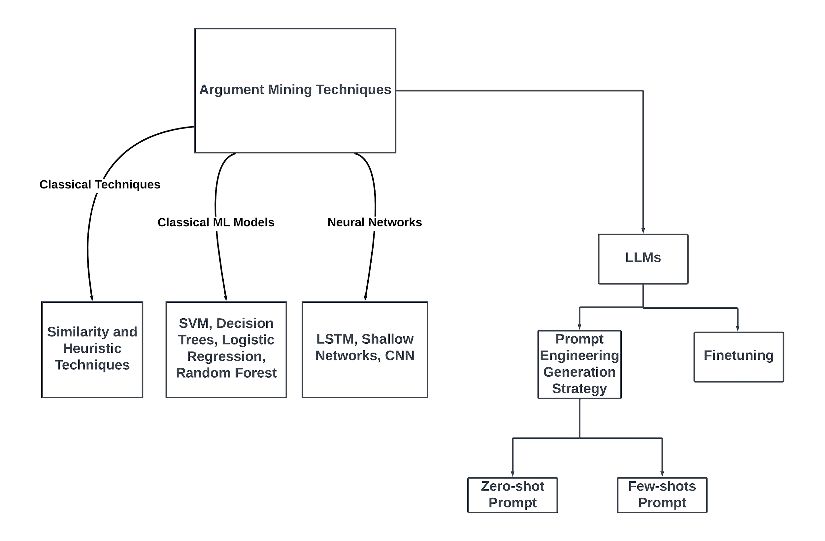
Taxonomy of Argument Mining Techniques
Research Gap →
Wide Exploration of LLMs in Argument Relation Identification
Notes:
We categorize existing techniques into classical and neural approaches, and introduce our focus on large language models, particularly their application in understanding complex argument structures not just in general contexts but specifically in financial arguments discussions.
In this part of our presentation, we shift our focus to the core goals of my thesis. We are primarily exploring how effective open-source large language models can be when fine-tuned and utilized through prompt engineering using zero-shot and few-shot prompts in our specific classification problem—identifying argument relations in financial texts. This exploration involves understanding which models adapt best to the nuances of financial discourse and how minimal input through zero-shot or few-shot learning can still yield highly accurate results. Our research questions, therefore, aim to dissect the impact of these approaches on the precision and adaptability of LLMs in a domain as critical and data-sensitive as finance.

Slide 6
Research Questions
RQ1: Which type of fine-tuned semantic knowledge —debate-specific, finance-specific, or general-purpose— is most relevant and effective for financial argumentation tasks?
RQ2: To what extent, do the number of shots (examples) in the prompt, and the method to choose them affect the quality of relation detection?
Notes:
Our research is guided by two main questions. First, Which type of fine-tuned semantic knowledge —debate-specific, finance-specific, or general-purpose— is most relevant and effective for financial argumentation tasks? Second, To what extent, do the number of shots (examples) in the prompt, and the method to choose them affect the quality of relation detection?

Slide 7
Problem Statement
Task: Argument clause relation identification (Binary text classification)
Data: FinArg (Alhamzeh et al. 2021)
Method: Fine Tuning and Prompt based classifiers of LLMs
Notes:
As we delve deeper into our exploration of argument mining, we focus on the core challenge of this thesis: argument clause relation identification, a binary text classification task essential for parsing financial texts. We utilize the FinArg dataset, developed by Alhamzeh et al. in 2021, which offers a robust foundation for analyzing financial arguments. Our approach harnesses Fine Tuning and Prompt-based classification with Large Language Models to dissect and understand argumentative structures effectively. This research aims to refine AI tools for financial text analysis, advancing our capability to interpret complex argument relations efficiently."

Slide 8
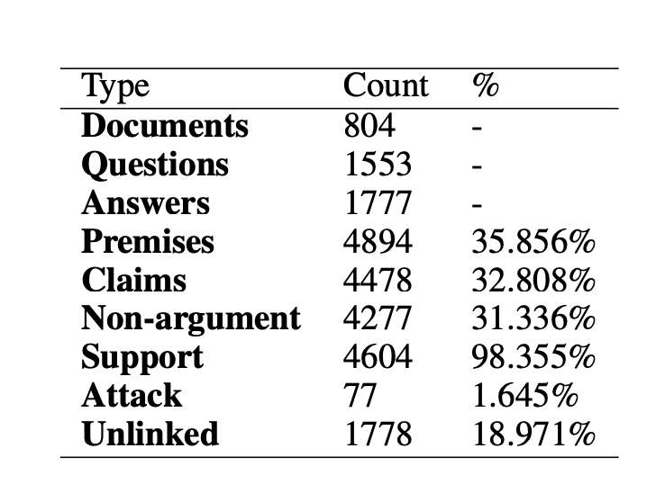
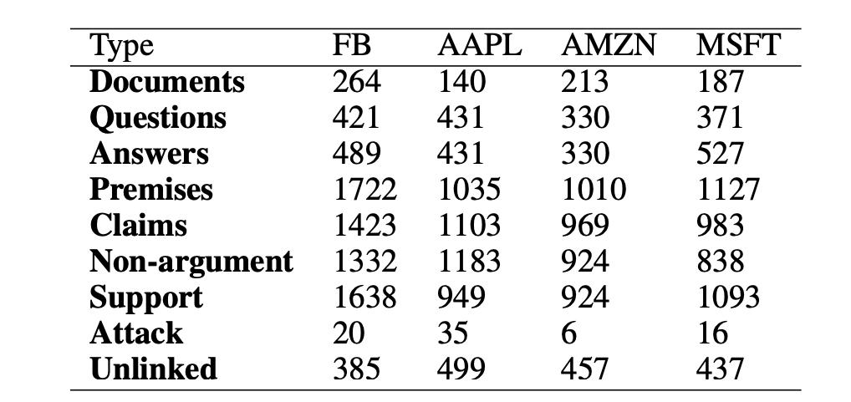
FinArg Dataset
Data Source: Financial Modeling Prep API.
Scope: Quarterly earnings calls of Amazon, Apple, Microsoft, and Facebook from 2015-2019, comprising 80 transcripts.
It’s Time to Reason: Annotating Argumentation Structures in Financial Earnings Calls: The FinArg Dataset (Alhamzeh et al., FinNLP 2022)
Financial Argument Quality Assessment in Earnings Conference Calls | SpringerLink (Alhamzeh et al.)
Notes:
This segment focuses on the relationship type classes within the FinArg Dataset, sourced from financial modeling prep API, covering earnings calls of major companies from 2015 to 2019.
From this statistics we face a significant issues with this data:
Annotation Focus: Annotations are primarily based on relation type classes rather than the identification of the relationships themselves which is limited. This limits our ability to deeply analyze the dynamics of argument structures.
Addressing this challenge is crucial for advancing our understanding of argumentation dynamics in financial texts.

Slide 9
Data Preparation
claim_text | relation_types | premise_texts
So I think we are experiencing deceleration from that perspective. | ['SUPPORT', ATTACK] | ["Obviously, we're lapping what's been good performance in 2019 where we've made a lot of product improvements and growing off a large base.", "The specific sort of high level of acceleration going into Q4, we're signing the specific optimizations that we're lapping in Q4, which were more significant."]
So it's a great benefit for sellers, and it only works if it's a great benefit for customers on the other side. | ['SUPPORT'] | ["So, yeah, I don't have a lot to share on that today, but I think you hit on the main point, is selection and opportunities for sellers in – who are with us in different countries to reach buyers outside of their home country."]
text | label
So I think we are experiencing deceleration from that perspective. [SEP] Obviously, we're lapping what's been good performance in 2019 where we've made a lot of product improvements and growing off a large base | 1
So I think we are experiencing deceleration from that perspective. [SEP] The specific sort of high level of acceleration going into Q4, we're signing the specific optimizations that we're lapping in Q4, which were more significant. | 1
So I think we are experiencing deceleration from that perspective. [SEP] So, yeah, I don't have a lot to share on that today, but I think you hit on the main point, is selection and opportunities for sellers in – who are with us in different countries to reach buyers outside of their home country. | 0
Notes:
In this section, we detail our data preparation strategy for argument mining. Our approach includes Positive Sampling, where we label logically related claim-premise pairs with '1', helping to identify clear argumentative structures. Conversely, in Negative Sampling, unrelated pairs are labeled with '0', training our models to discern non-logical connections. We also implement Data Balancing by ensuring an equal number of related and unrelated pairs, about 5000 each, to avoid model bias towards more frequent classes. These steps are crucial for preparing our dataset for robust training and validation.

Slide 10
Research Question 1
Which type of fine-tuned semantic knowledge —debate-specific, finance-specific, or general-purpose— is most relevant and effective for financial argumentation tasks?
Notes:
Transitioning from the foundation of our research—identifying and understanding argument structures—we now encounter a pivotal question that directs the trajectory of our study. As we delve deeper into the application of Large Language Models or LLMs for financial argumentation, a fundamental query emerges: What type of fine-tuned semantic knowledge is most effective?
Is it the debate-specific models, which are honed for argumentative flair and sharpness, the finance-specific models tailored for economic vernacular and concepts, or the general-purpose models with their broad knowledge base?
Let’s delve into how each type of model performs in real-world testing scenarios, starting with our rigorous experiment setups and methodologies.

Slide 11
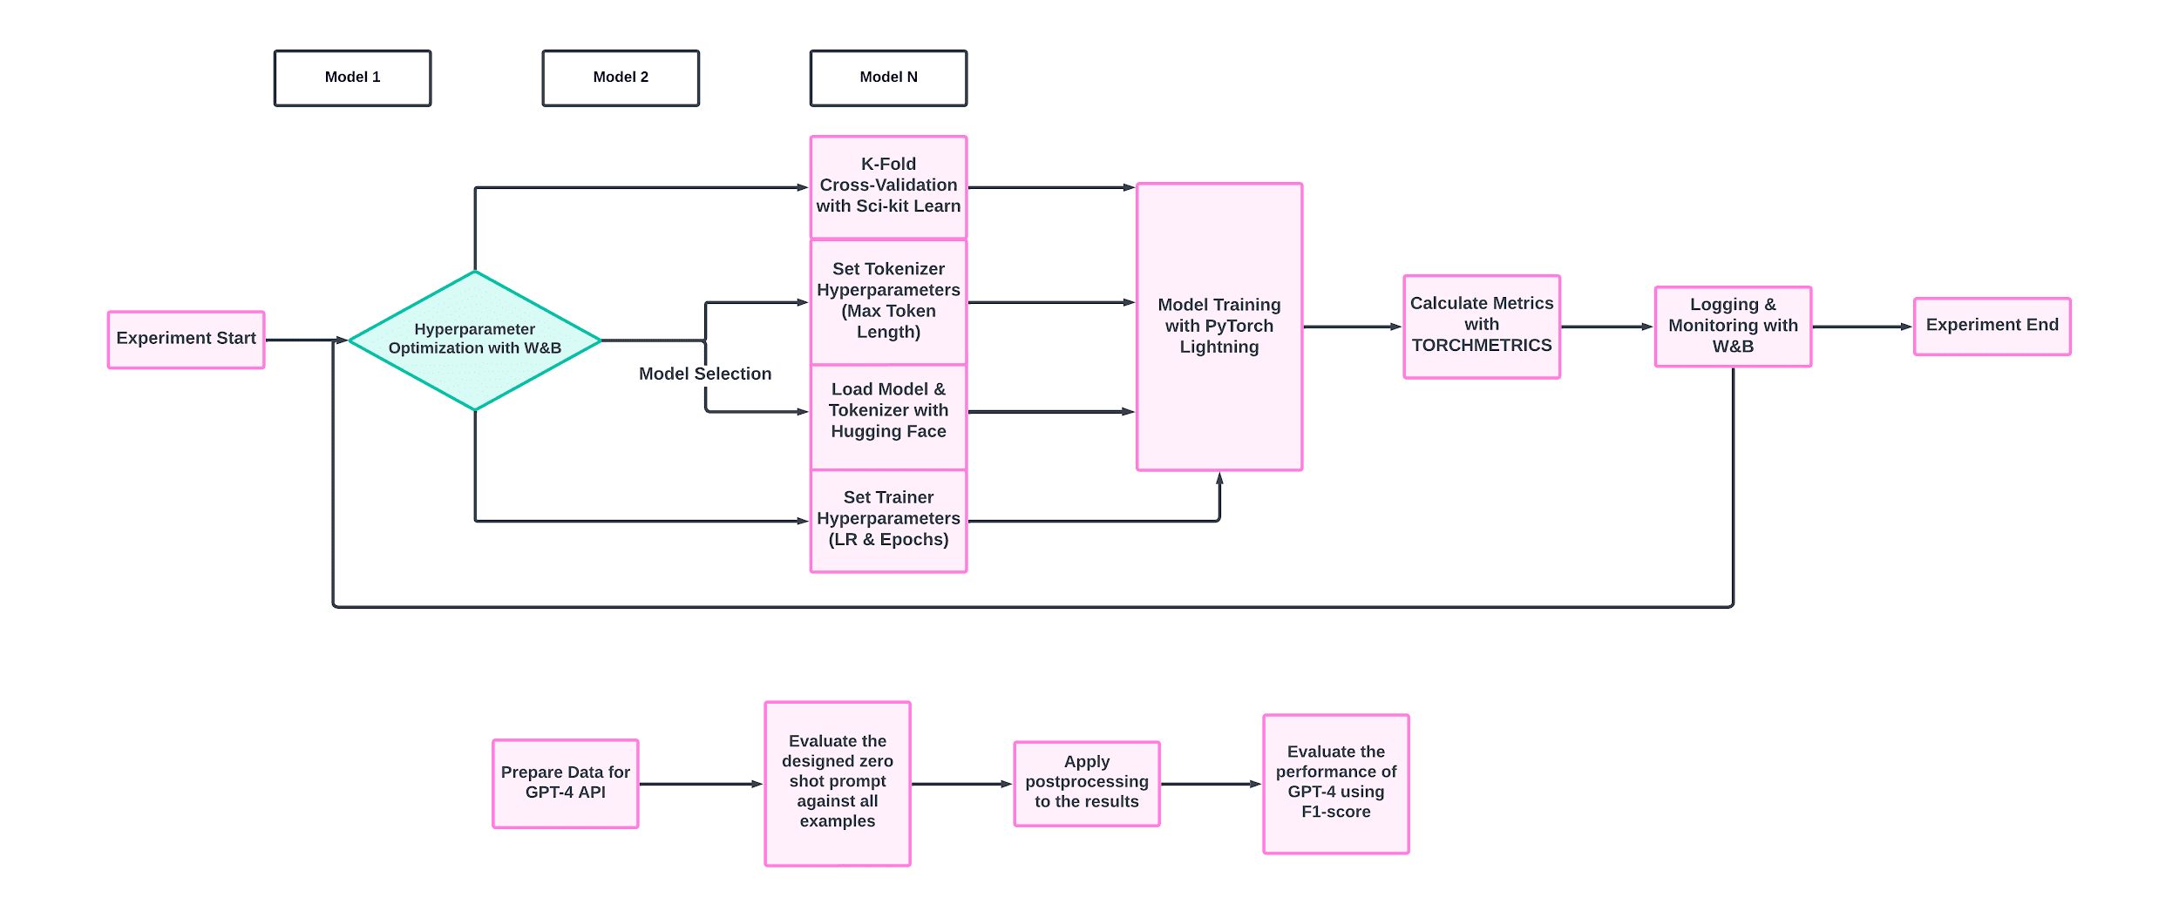
Methodology (Fine-tuning)
Max Length: (64, 128, 256)
Learning rate: (2e-5, 3e-5, 5e-5)
Epochs: (2 - 5)
5-fold cross validation
Bert-base-uncased
roberta-base
Distilbert-base-uncased
bigscience/bloom-560m,1b1,7b1
vicuna-13b_rm_oasst-hh
llama-2-7B-Guanaco-QLoRA-GPTQ
vicuna-13b-v1.5
Gpt4-x-alpaca
Llama-3 (8B)
ArgumentMining-EN-ARI-Debate
ArgumentMining-EN-AC-Essay-Fin
ArgumentMining-EN-AC-Financial
ArgumentMining-EN-CN-ARI-Essay-Fin
roberta-argument
roberta-base-150T-argumentative-sentence-detector
finbert-tone-finetuned-finance-topic-classification
deberta-v3-base-finetuned-finance-text-classification
finbert
FinancialBERT-Sentiment-Analysis
Roberta-Earning-Call-Transcript-Classification
20 Models
Notes:
Let’s walk through our methodology for fine-tuning our models, beginning with the Experiment Start.
First, we select multiple models to consider. We then enter a phase of hyperparameter optimization using Weights & Biases to ensure optimal settings.
Following this, we employ K-Fold cross-validation using Sci-kit Learn to validate our models, ensuring robustness and generalizability. This involves setting tokenizer hyperparameters like maximum token length, loading the model and tokenizer via Hugging Face, and setting up the training parameters including learning rate and epochs.
Model training is conducted with PyTorch Lightning, a framework that allows for efficient and scalable training.
Once the models are trained, we calculate performance metrics using Torchmetrics to evaluate model efficiency and accuracy.
The process is closely monitored and logged using Weights & Biases, allowing for real-time tracking and adjustments.
The experiment concludes with a review of these metrics and any necessary final adjustments.
As shown here we have tested 20 models categorized into general purpose, debased based and financial based models
Also you can see here are the ranges of hyperparameter we have used in this experiment evaluated by 5-fold cross validation

Slide 12
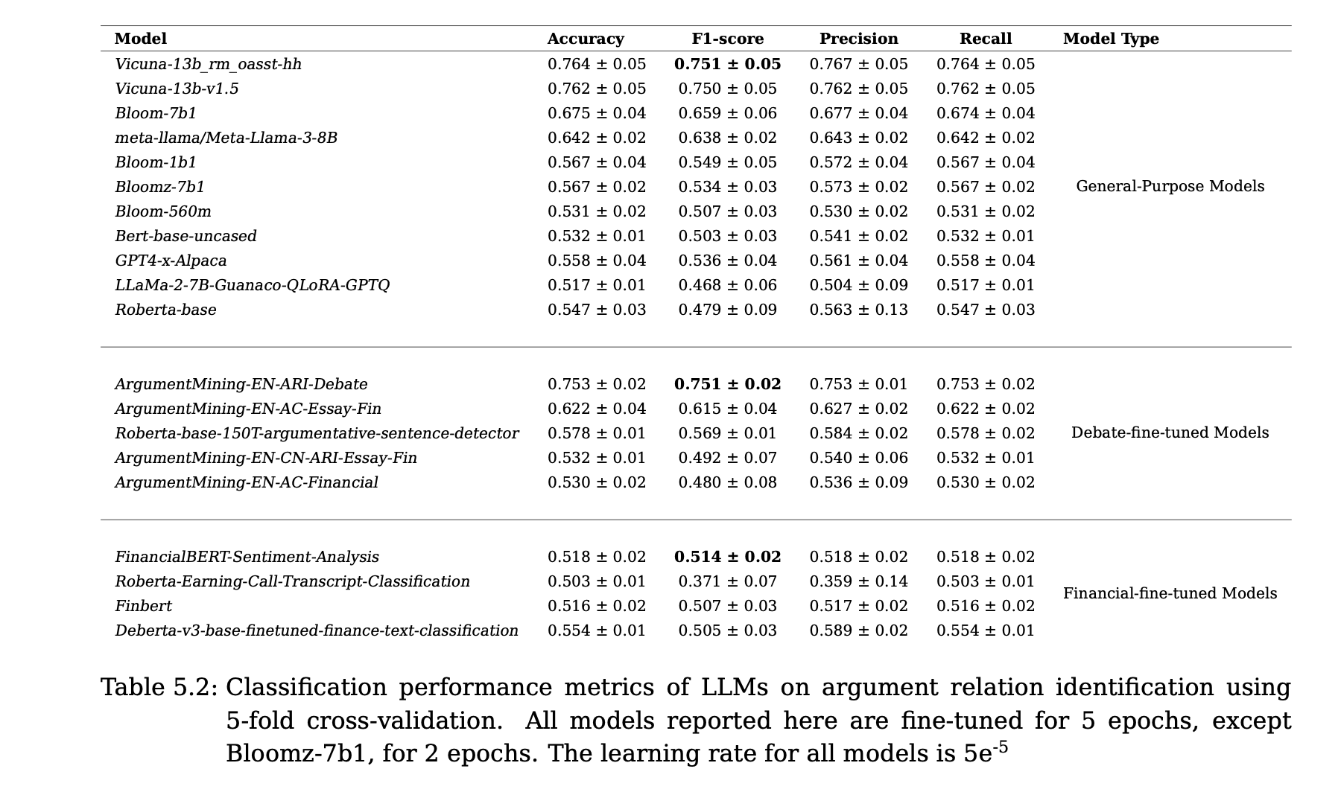
Result Analysis
≈1800 runs
Table 2:
https://wandb.ai/master-thesis-uni-passau/master-thesis/table?workspace=user-yasserotiefy
Notes:
In our comprehensive analysis of model performance, we've seen some standout results that are worth highlighting. Each model category—general-purpose, debate-fine-tuned, and financial-fine-tuned—has shown unique strengths. Notably, the debate-fine-tuned & general purpose models generally delivered superior f1 score, demonstrating their robustness in capturing the nuances of argumentative financial texts. Additionally, we extended our testing to include a newer model, the LLaMA-3 8B version. This model, despite its recent introduction, showed promising results, so it will be good plan to test larger version in this case 70B. This slide aims to summarize these findings, showcasing not only the best performers but also the potential of upcoming technologies in enhancing our understanding of financial argumentation.

Slide 13
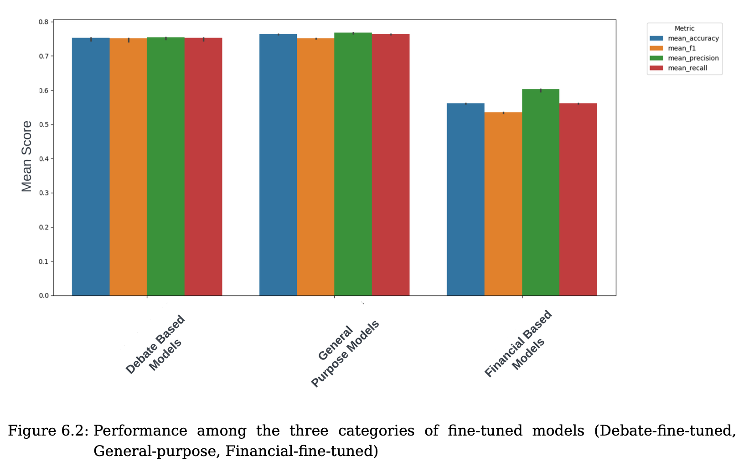
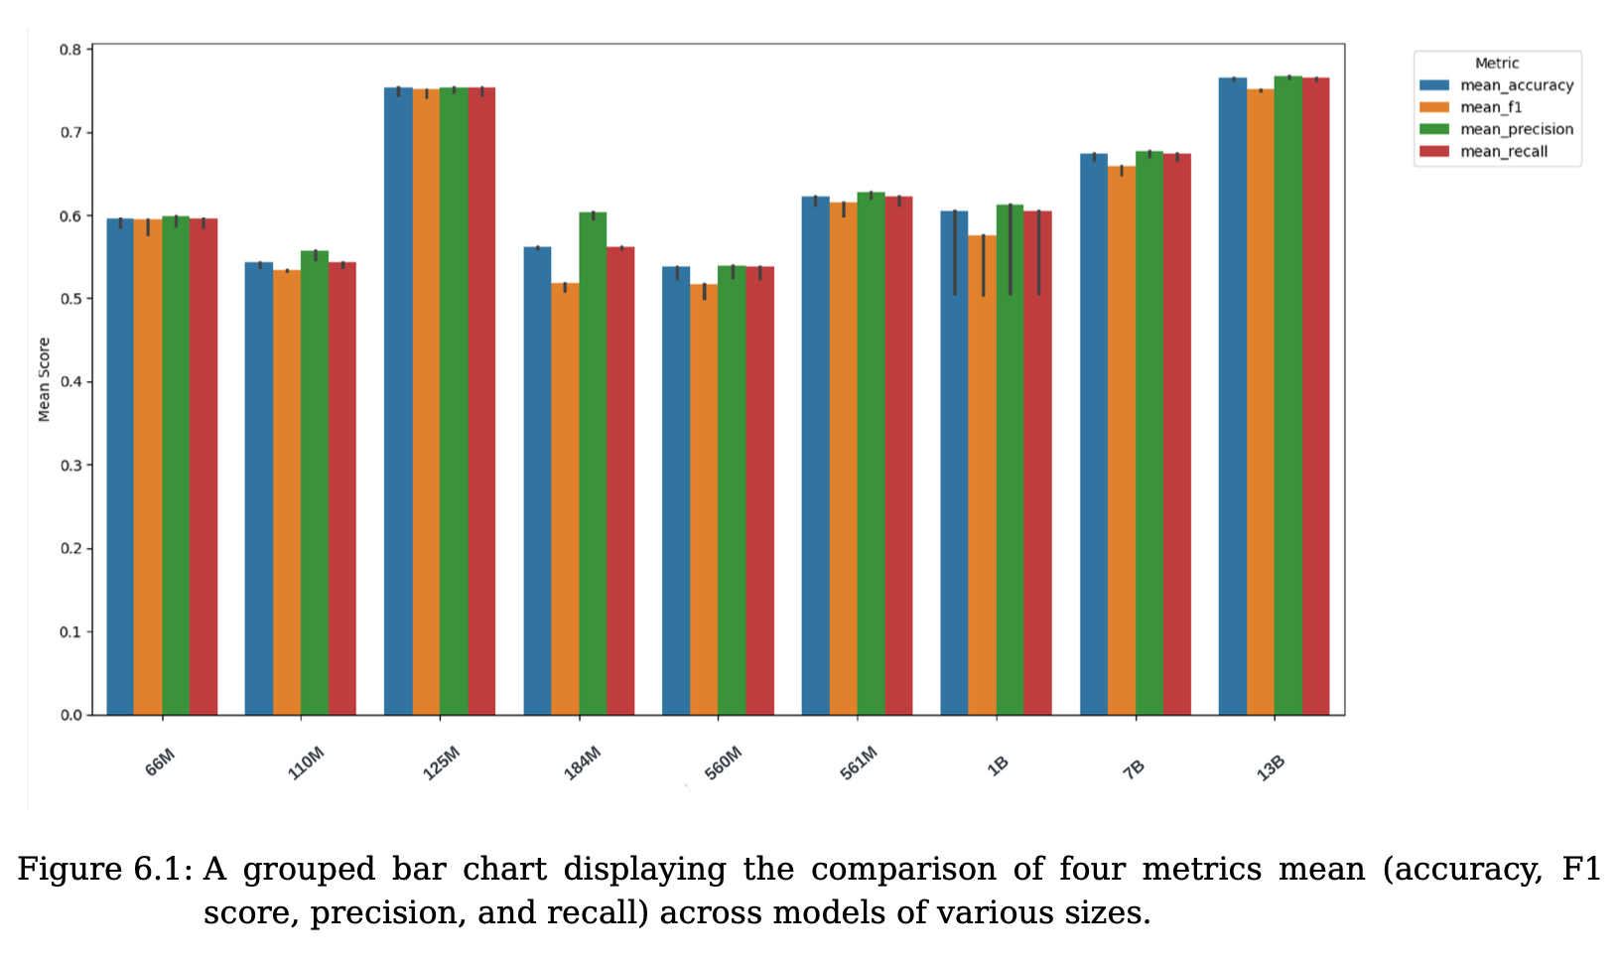
Result Analysis Cont.
Notes:
We also analyze how different model sizes and category impact model performance, which helps us refine our models further to enhance their accuracy and efficiency.
Figure 6.1 reveals that despite some variability, model size does not significantly affect key performance metric F1-score—once models are appropriately fine-tuned.
Transitioning to Figure 6.2, we find that debate-fine-tuned models consistently outperform general-purpose and financial-fine-tuned models across F1-score however the difference between it and general purpose models is not significant. This demonstrates the potent effect of domain-specific tuning, particularly in debate contexts, where it substantially boosts model performance.

Slide 14
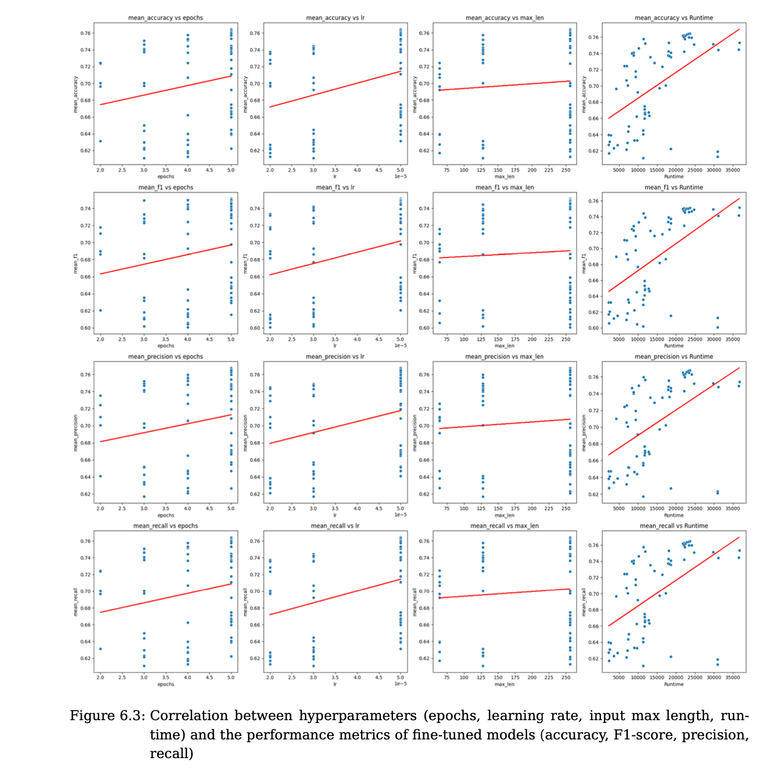
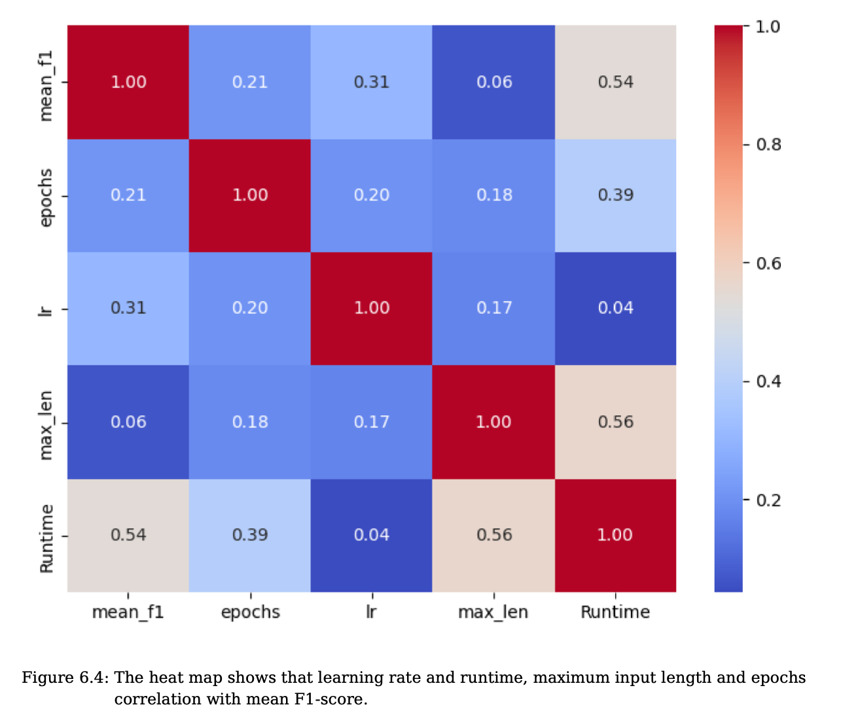
Hyperparameter Analysis
Yasser Otiefy and Alaa Alhamzeh. 2024. Exploring Large Language Models in Financial Argument Relation Identification. In Proceedings of the Joint Workshop of the 7th Financial Technology and Natural Language Processing, the 5th Knowledge Discovery from Unstructured Data in Financial Services, and the 4th Workshop on Economics and Natural Language Processing @ LREC-COLING 2024
Notes:
We also analyze how different hyperparameters impact model performance, which helps us refine our models further to enhance their accuracy and efficiency.
Let’s dive into the nuanced relationships between hyperparameters and their impact on model performance, as visualized in Figures 6.3 and 6.4. You'll see a series of scatter plots and heatmap examining the effects of epochs, learning rate, maximum input length, and runtime on F1-score. These plots reveal that adjustments in the learning rate and the number of epochs correlate strongly with improvements in model performance, emphasizing the significance of these parameters in our tuning process.
For a more in-depth analysis, I invite you to refer to our paper titled 'Exploring Large Language Models in Financial Argument Relation Identification', This paper provides detailed insights into these results and our methodologies.

Slide 15
Research Question 2
To what extent, do the number of shots (examples) in the prompt, and the method to choose them affect the quality of relation detection?
Notes:
As we go deeper into our exploration of fine-tuning and prompt engineering with large language models, let’s revisit and re-motivate our second critical research question: To what extent do the number of shots, or examples in the prompt, and the method used to select them affect the quality of relation detection in our argumentation tasks? This question is pivotal because it addresses how efficiently these models can adapt to new, unseen data with minimal examples, a common scenario in dynamic financial environments.
Understanding this will not only enhance our model's practicality in real-world applications but also allow us to optimize our approach to training with precision. This inquiry seeks to determine the most effective strategies for deploying these advanced models in settings where data may be scarce or rapidly changing, ensuring that financial analysts can rely on the robustness and agility of AI-driven insights.

Slide 16
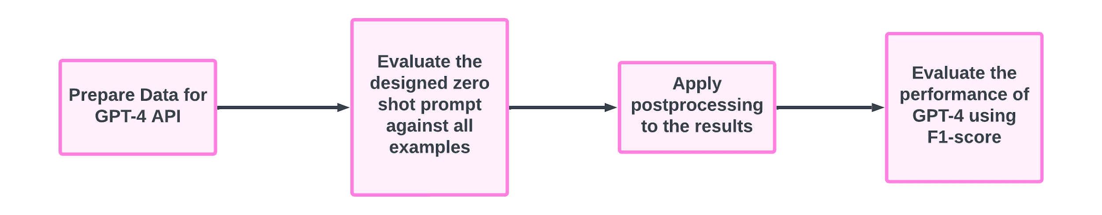
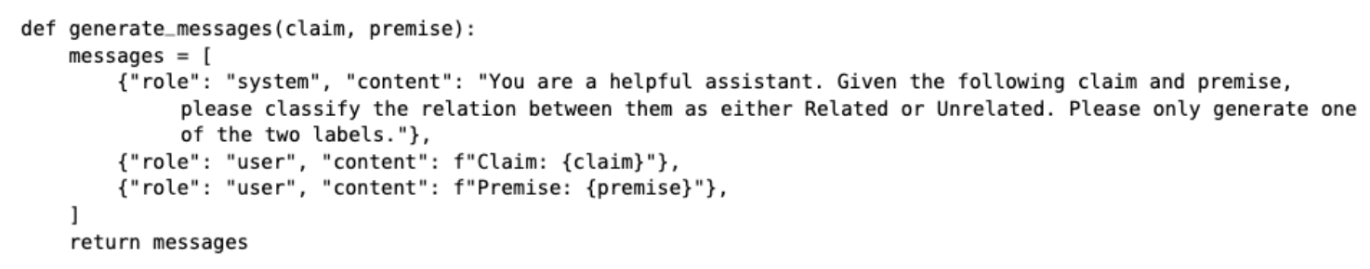
Methodology (Zero-shot Prompt)
Notes:
Building on our exploration of large language models, we now turn to prompt based classifiers,
We use the GPT-4 API for zero-shot prompt evaluation by formatting data to analyze claim-premise relationships without specific training.
After deploying prompts, we test the model's inherent understanding and refine outputs through postprocessing.
Our main metric, the F1-score, assesses precision and recall, illustrating GPT-4's capability in processing complex texts and setting the foundation for further few-shot learning enhancements.

Slide 17
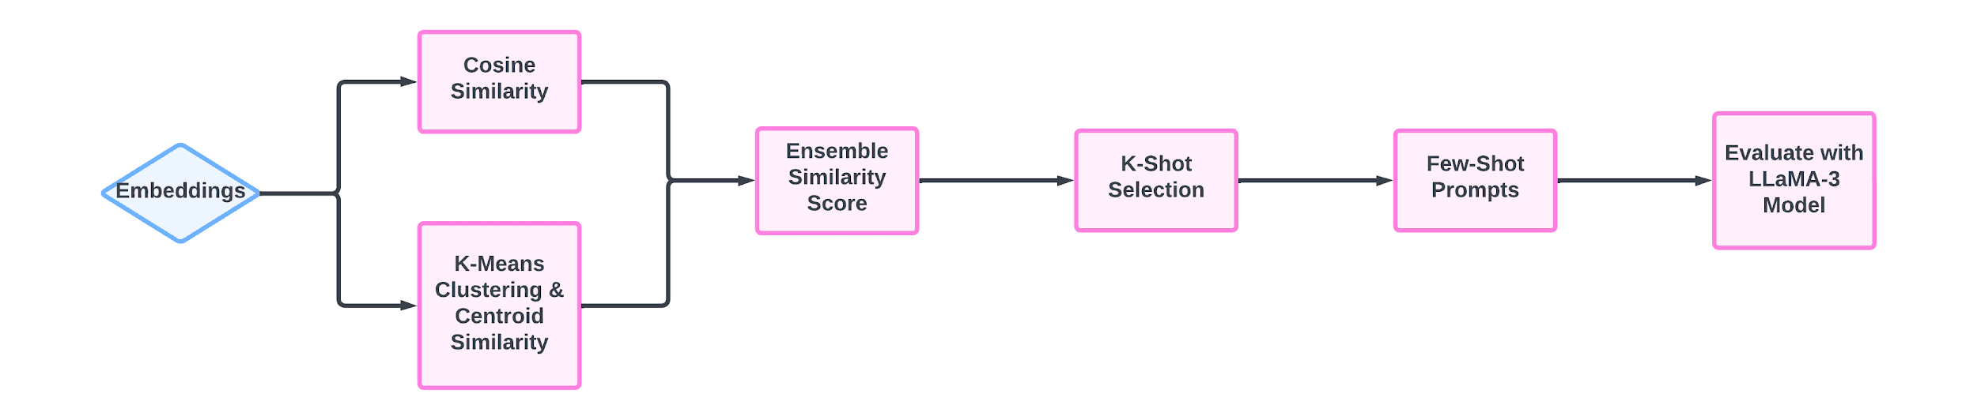
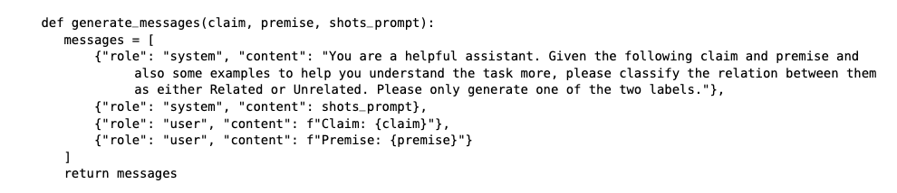
Methodology (Few-shots Prompt)
Notes:
Building on our zero-shot findings, we transition to few-shot learning with LLama-3, chosen over GPT-4 for cost-efficiency in financial argument mining.
We initiate by creating the embedding using OpenAI embeddings
Then we calculate and combine clustering and cosine based similarities to find the best representative data point for every class in our dataset.
This informs our K-shot selection, optimizing LLama-3's exposure to a condensed yet diverse dataset.
This few-shot approach underlines how strategic data handling and model selection can significantly boost performance in argument mining.
Please note: shots could be selected using random approach or the explained approach and we will see the results of both approaches in the next slide

Slide 18
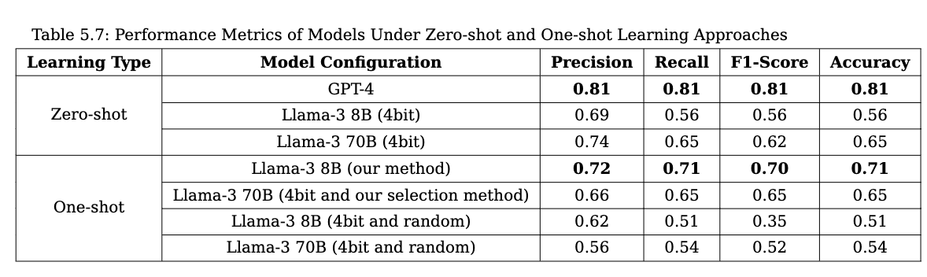
Prompt Engineering Results
Table 4: Performance Metrics of Models Under Zero-shot and One-shot Learning Approaches
Notes:
we focus on the F1-scores from our prompt engineering experiments with LLama-3 and GPT-4, using the entire dataset as the test set for a comprehensive evaluation. GPT-4 excelled in a zero-shot scenario, achieving an F1-score of 0.81, demonstrating its robust generalization abilities. Meanwhile, LLama-3 8B, using custom prompts, reached an F1-score of 0.70 using our selection method. The LLama-3 70B, evaluated with a single one-shot example, scored a competitive 0.65, Also we can notice that the random approach has worst results for this experiment with F1 score 0.52.
These results validate the effectiveness of our tailored prompts and strategic model selection, emphasizing their real-world applicability in scenarios with limited training data.

Slide 19
Conclusion & Future Work

Slide 20
Conclusion
Application of Argument Mining
Use of Large Language Models (LLMs)
Performance Metrics
LLaMA-3 Model Evaluation
Impact of Architecture and Training Data
Notes:
Argument mining is critical for fields like assisted writing, fact-checking, and legal analysis, and the thesis focused on using argument mining in financial texts, specifically earnings conference calls.
Large Language Models (LLMs) such as GPT-4, fine-tuned models for debate contexts, and financial analysis were evaluated.
Performance varied significantly (F1-scores: 0.37 to 0.75), with GPT-4 achieving the highest zero-shot learning F1-score of 0.81.
LLaMA-3 models showed promising results, highlighting efficiency in memory usage but challenges in maintaining high performance.
The architecture and specific training data significantly influence the models' effectiveness.

Slide 21
Future Work
Refining Fine-Tuning Techniques
Adjust the number of trainable layers to allow for deeper adaptation to the financial domain.
Explore diverse methods for automated prompt generation to improve zero-shot and few-shot learning.
Enhancing Prompt-based Processes
Explore the impact of using more than one shot in training to improve models' understanding and classification abilities.
Experiment with a variety of models beyond those currently tested for deeper insights.
Notes:
Enhancing Training Processes
Explore the impact of using more than one shot in training to improve models' understanding and classification abilities.
Experiment with a variety of models beyond those currently tested for deeper insights.
Refining Fine-Tuning Techniques
Adjust the number of trainable layers to allow for deeper adaptation to the financial domain.
Explore diverse methods for automated prompt generation to improve zero-shot and few-shot learning.

Slide 22
Thanks for Your Attention
Notes:
If there is any question, please feel free to ask!
In 4 bit quantization: Convert the weights of the neural network from 32-bit floating-point numbers to 4-bit integers.

Slide 23
Future Work cont.
Efficiency and Interpretability
Develop lighter model versions that maintain effectiveness with lower computational demands.
Employ interpretability and explainability tools (e.g., SHAP, LIME, attention visualization) to understand model behavior better.
Expanding Scope
Apply argument mining to more detailed analyses, combining textual data with quantitative financial metrics.
Implement these technologies in real-time scenarios, such as live earnings calls, for immediate insights.

Slide 24
Experiment Workflow
Trainer
Bert-base-uncased
roberta-base
Distilbert-base-uncased
bigscience/bloom-560m,1b1,7b1
vicuna-13b_rm_oasst-hh
llama-2-7B-Guanaco-QLoRA-GPTQ
vicuna-13b-v1.5
Gpt4-x-alpaca
ArgumentMining-EN-ARI-Debate
ArgumentMining-EN-AC-Essay-Fin
ArgumentMining-EN-AC-Financial
ArgumentMining-EN-CN-ARI-Essay-Fin
roberta-argument
roberta-base-150T-argumentative-sentence-detector
finbert-tone-finetuned-finance-topic-classification
deberta-v3-base-finetuned-finance-text-classification
finbert
FinancialBERT-Sentiment-Analysis
Roberta-Earning-Call-Transcript-Classification
19 Models
Premise
Tokenizer
LLM
Label
Claim
Max Length
Models
Related Or
Not_Related
Trainer Hyperparameters:
Learning Rate
Epochs
Notes:
The models can be categorized into three types:
General-purpose models trained on diverse domain data.
Debate-based models trained on datasets with an argumentative structure from debates.
Financial data-backed models designed for solving financial classification challenges.

Slide 25
Conclusion cont.
Importance of Strategic Model Selection
Importance of few shots selection methods
Optimizing Performance through Prompt Engineering and Fine-Tuning
Notes:
Strategic model selection based on task requirements is essential, as different models excel in different contexts.
Efficient prompt engineering and fine-tuning are critical for optimizing model performance in specialized tasks.

Slide 26
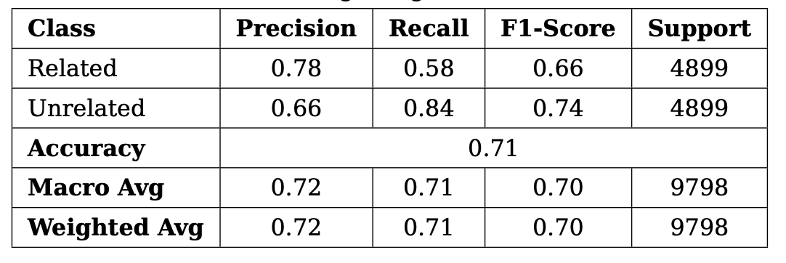
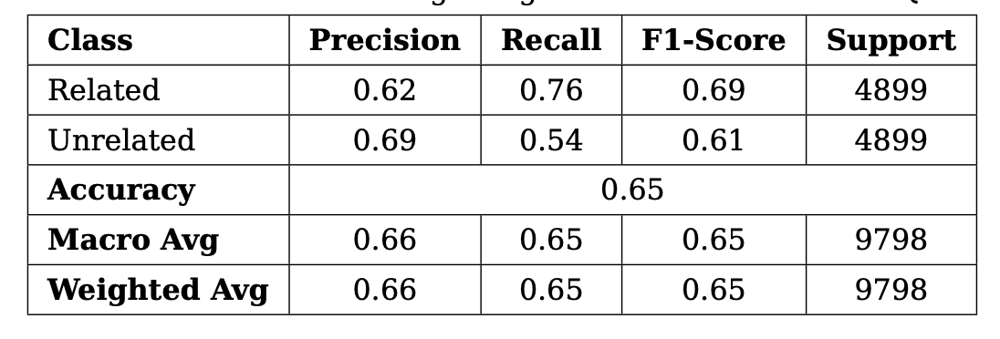
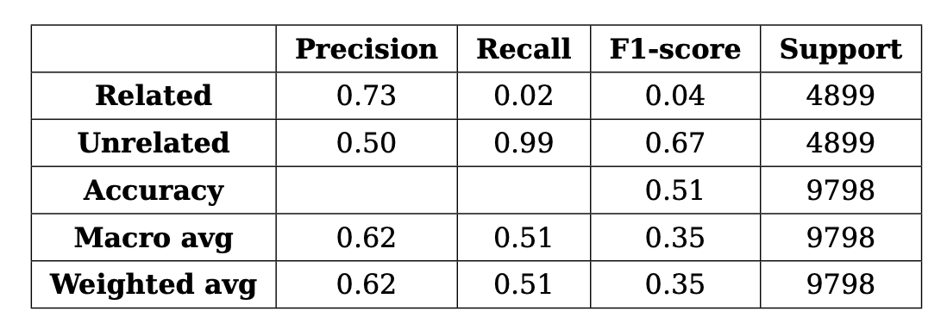
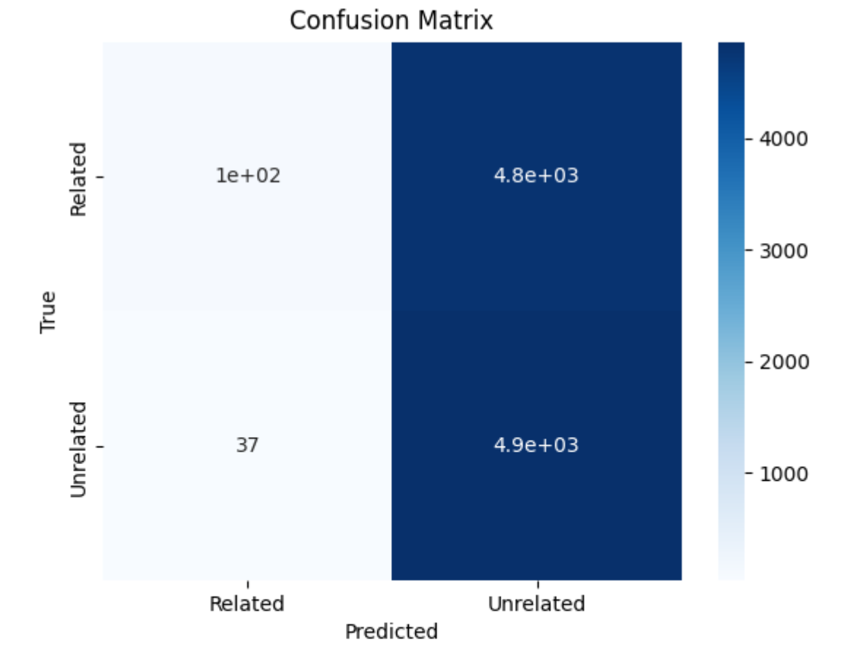
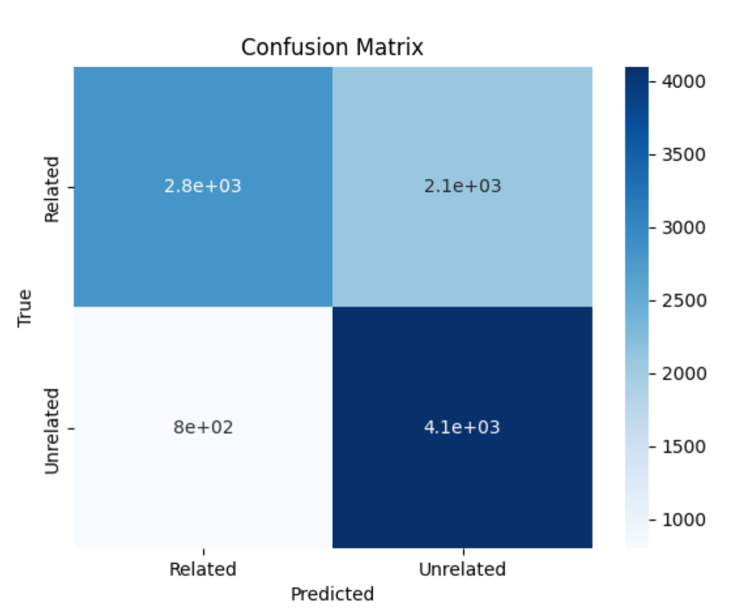
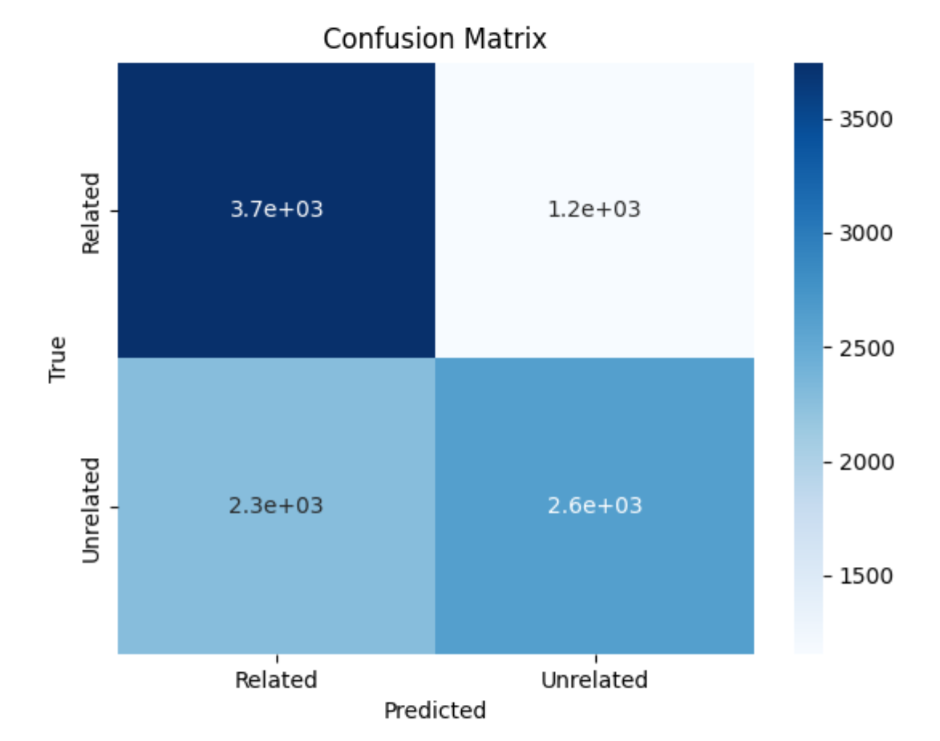
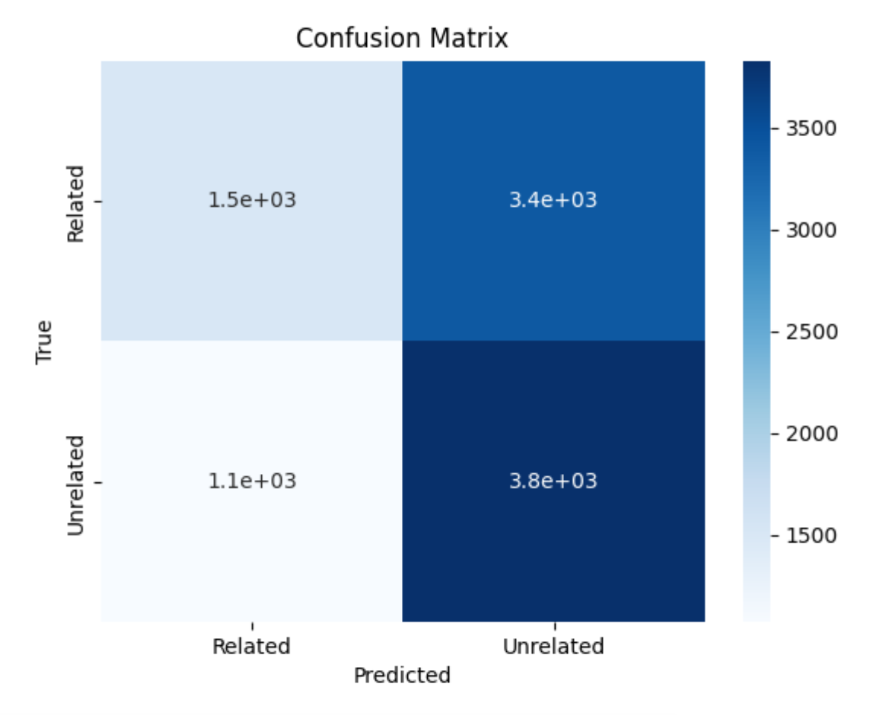
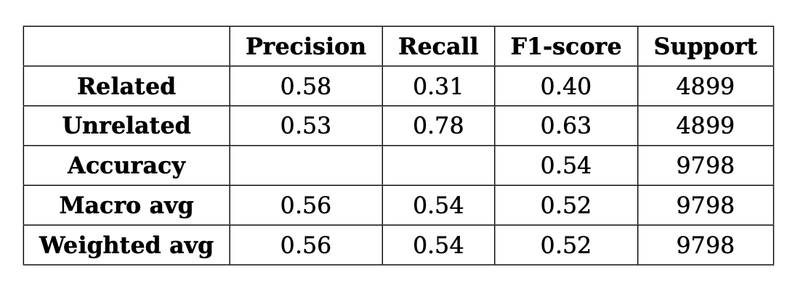
1-shot Prompt with Llama-3
Llama-3 8B with OUR METHOD for shot selection
Llama-3 70B with OUR METHOD for shot selection and 4 bit quantization
Llama-3 8B with random shot selection
Llama-3 70B with random shot selection and 4 bit quantization

Slide 27
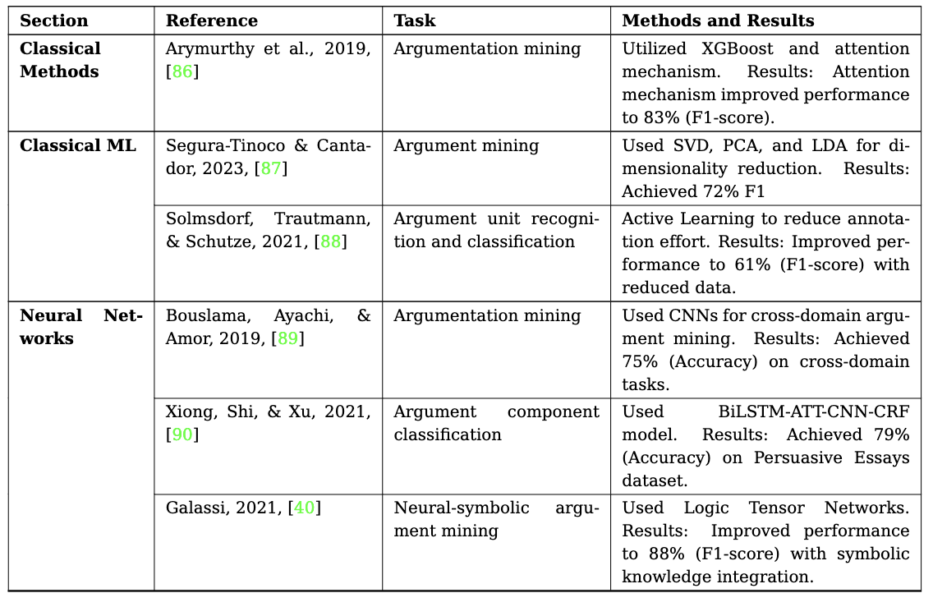
Related Work
Notes:
It would be better to have the table written and not as photo, make sure to clarify the references then, and to preview the task! Method and results are separated columns! Put also a caption to clarify that those are most related up 2019 because the table seems small for a SOTA table!

Slide 28
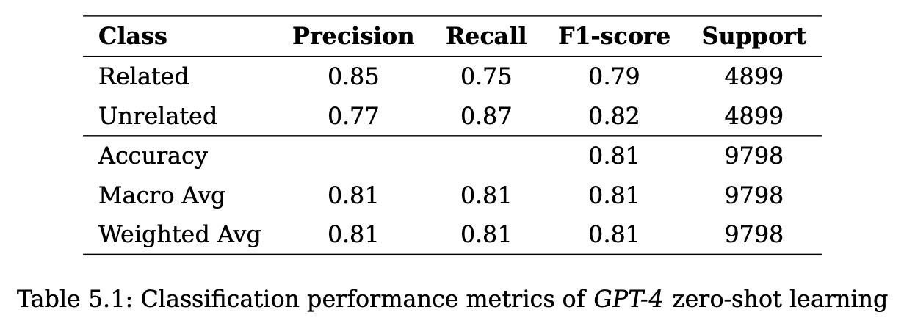
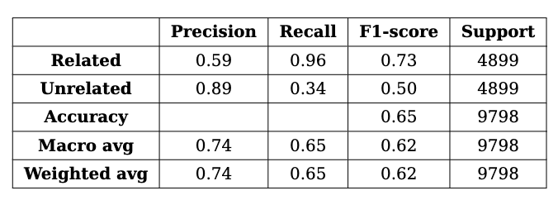
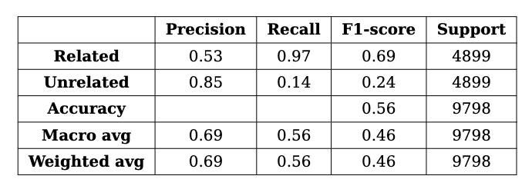
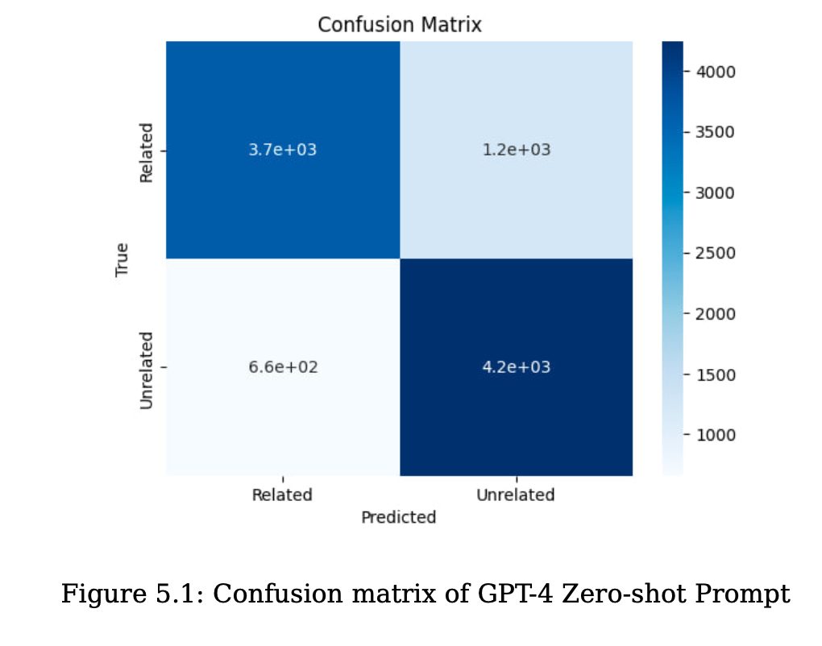
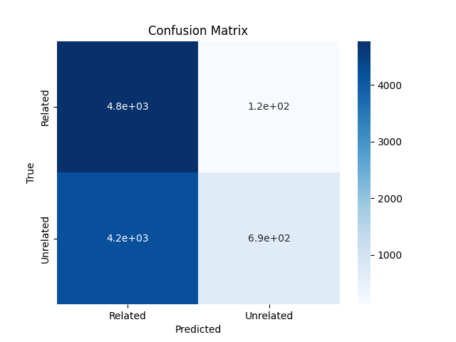
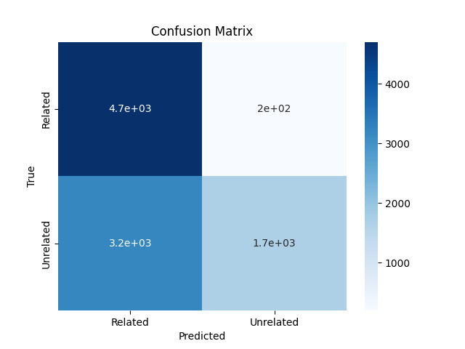
Zero-shot Prompt
Llama-3 8B with 4 bit quantization
Llama-3 70B with 4 bit quantization
GPT-4

Slide 29
Results

Slide 30
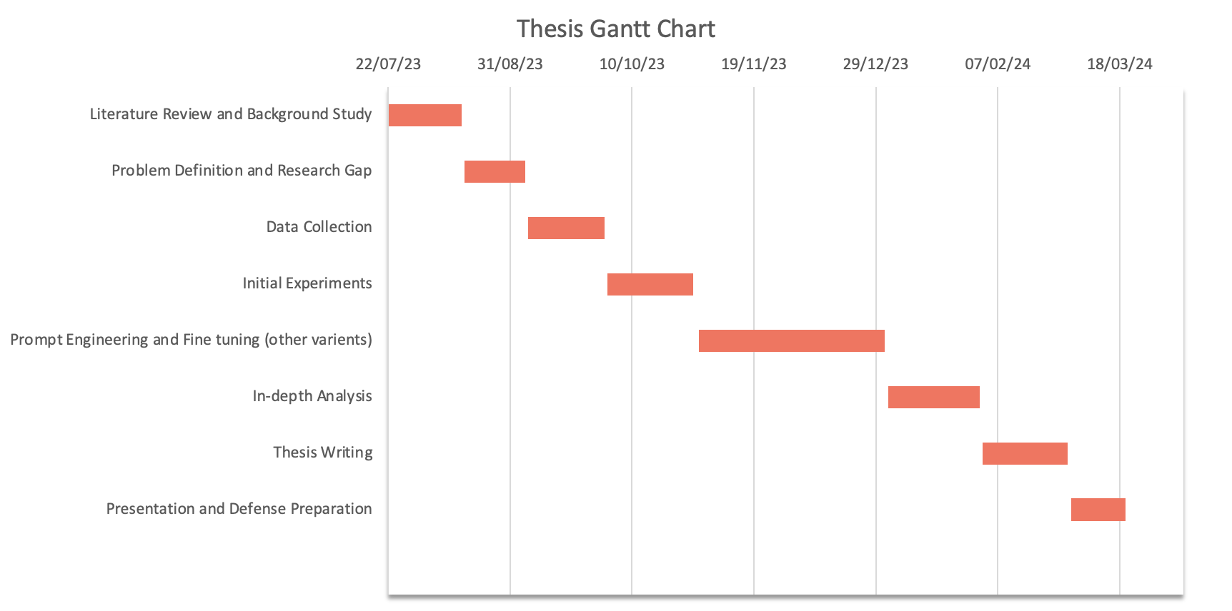
Future Work
Notes:
Start talk from the line:
Investigate prompt engineering and its various techniques.
Explore alternative fine-tuning methods.
Conduct a comprehensive analysis of the results.

Slide 31
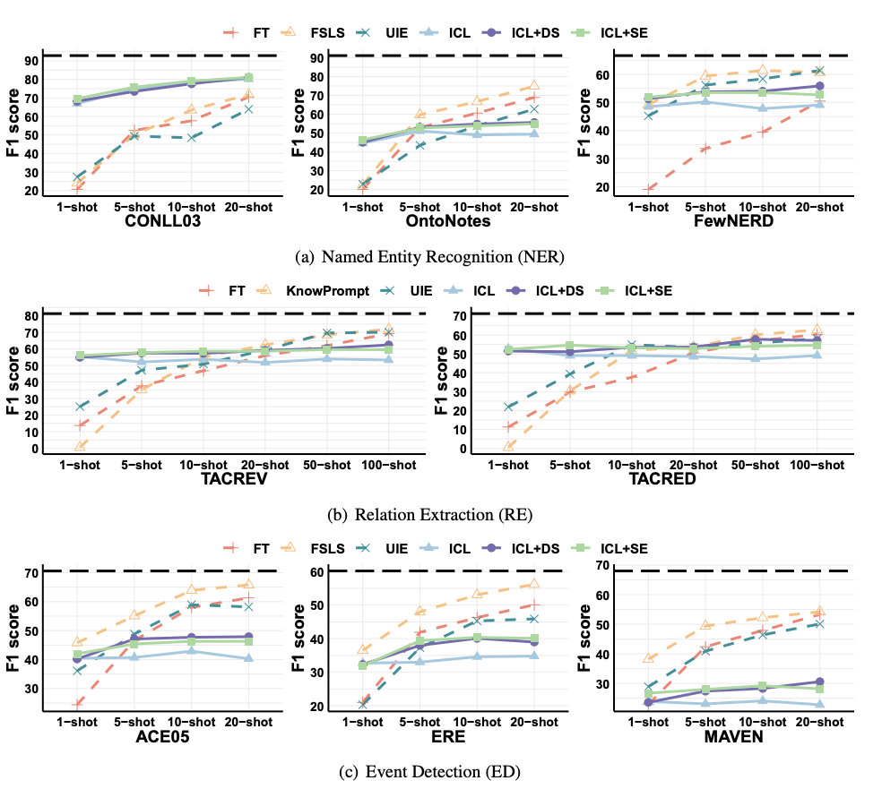
Large Language Model Is Not a Good Few-shot Information Extractor, but a Good Reranker for Hard Samples!
Study
LLMs
Proposed Strategy
Result
Figure 2: Overall results of 4 supervised SLM-based methods (dashed lines) and 3 LLM-based ICL methods
(solid lines) on eight datasets. FT: Fine-tuning. ICL: In-context Learning. DS: Demonstration Selection. SE:
Self-ensemble. The results are averaged over 5 repeated experiments.
Large Language Model Is Not a Good Few-shot Information Extractor, but a Good Reranker for Hard Samples!
Notes:
Study extensively compared Large Language Models (LLMs) and small Pre-trained Language Models (SLMs) on diverse datasets.
LLMs face challenges in few-shot information extraction due to task format and limited capacity. Despite their costs, LLMs are superior in reranking and rectifying tough samples.
Introduced a new "filter-then-rerank" method combining both model strengths.
This approach improved F1-score by 2.1% and minimized OpenAI API expenses.
The graph presents the average results from five repeated experiments across eight datasets. It compares four supervised methods based on Small Language Models (SLMs) – depicted by dashed lines – and three methods based on Large Language Models (LLMs) that employ In-context Learning (ICL) – represented by solid lines. The methods include Fine-tuning (FT), Demonstration Selection (DS), and Self-ensemble (SE).
The paper proved insightful, especially for comparative result analysis and experiment discussions.

Slide 32
Related Work
Study | Model | Problem | Results Range | Dataset
Joint extraction of argument components and relations | IEEE Conference Publication | SVM/Decision Tree/Logistic regression/Random forest | Argument component types and the relations classification | 0.50 - 0.60 f1 score | Persuasive essay
Research on the Classification of Argument Components Based on BiLSTM-ATT-CNN-CRF | IEEE Conference Publication | Bi LSTM-ATT-CNN-CRF | Argument component classification | 0.57-0.71 f1 score | Persuasive essay
Knowing Opposing Arguments in Persuasive Essays Using Random Forest Classifier | IEEE Conference Publication | Random Forest/SVM | opposing arguments classification | 0.73-0.84 f1 score | Persuasive essay
Argument Mining with Modular BERT and Transfer Learning | BERT–MINUS | Link Identification/ Argument Type Classification | 0.52-0.81 f1 score | Persuasive essay
Predicting Effective Arguments with A Natural Language Processing Model | DeBERTa | Effective Arguments Classification | 0.61 - 0.73 Cross entropy | Persuasive essay
Argument Mining: A Survey | Computational Linguistics | MIT Press | Similarity and heuristic approaches | Relationship classification | 0.74-0.77 f1 score | Microtext and AAEC
Yes, we can! Mining Arguments in 50 Years of US Presidential Campaign Debates | SVM/LSTM/Shallow Network | Argumentative sentences detection/Argumentative components identification | 0.35 - 0.64 f1 score | ElecDeb60To16/Dataset
Will It Blend? Mixing Training Paradigms & Prompting for Argument Quality Prediction | Prompting GPT-3 | Argument Quality Prediction | 0.57 - 0.75 f1 score | lm-kbc-dataset2023
Notes:
Given that our interest is to explore the recent llms capabilities in terms or Argument mining we list here only the research studies starting from 2022
The table presents various recent studies focused on argument mining. These studies utilize diverse models, such as SVM, LSTM, BERT variants, and more, to address problems related to argument component classification, link identification, and effective argument detection. The research works range from examining argument components in persuasive essays to mining arguments from US Presidential debates. The performance of these models, as indicated by their results, varies widely, with F1 scores ranging from 0.35 to 0.84 and cross-entropy values noted for specific models. The datasets used for evaluation also vary, mostly persuasive essays and other datasets.
As conclusion Relation classification is not explored by LLMs

Slide 33
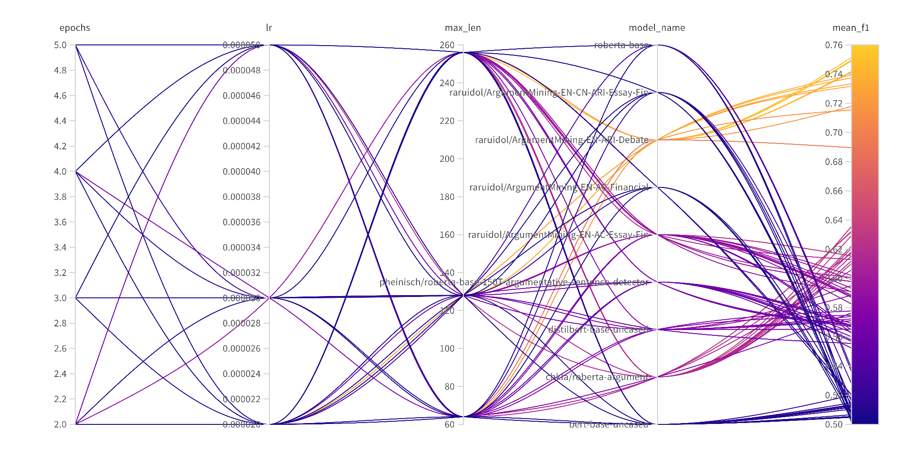
Hyperparameter Overview

Slide 34
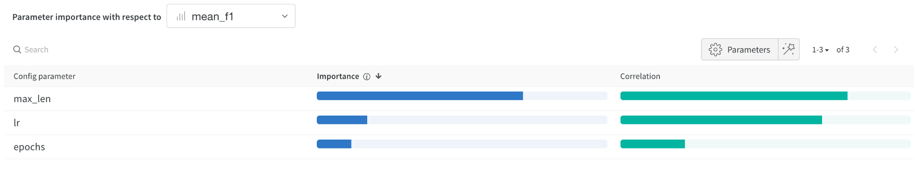
Hyperparameter Correlation with Mean F1 OverAll Runs
Best
256
0.00005
5
Hyperparameter importance panel untangles the complicated interactions between highly correlated hyperparameters.
It helps to fine tune of the hyperparameter searches by showing which of the hyperparameters matter the most in terms of predicting model performance.
Correlation is the linear correlation between the hyperparameter and the chosen metric (in this case mean_f1).
A high correlation means that when the hyperparameter has a higher value, the metric also has higher values and vice versa.
Richer Context
Training Consistency
Avoids Truncation
Better Representation
Complex Tasks
https://docs.wandb.ai/guides/app/features/panels/parameter-importance
Notes:
Explain why max_len has the highest correlation?
Richer Context: Longer sequences provide more information, aiding accurate decisions.
Training Consistency: Models might be better with lengths they were trained on.
Avoids Truncation: Essential information isn't cut off, improving performance.
Better Representation: Longer sequences capture more features, enhancing understanding.
Complex Tasks: Comprehensive tasks like the one in hands tends to benefit from more extended text.

Slide 35
Research Proposal Cont.
Evaluation Metrics → Mean F1-Score → (K-Fold Cross Validation)
Tools
Pytorch Lightning, LangChain, Ludwig, WandB, Vector Store.
Expected Outcomes
A comparative analysis of different fine-tuning and prompting engineering techniques.
Recommendations for best LLMs & generation strategies best suited for argument mining tasks.

Slide 36
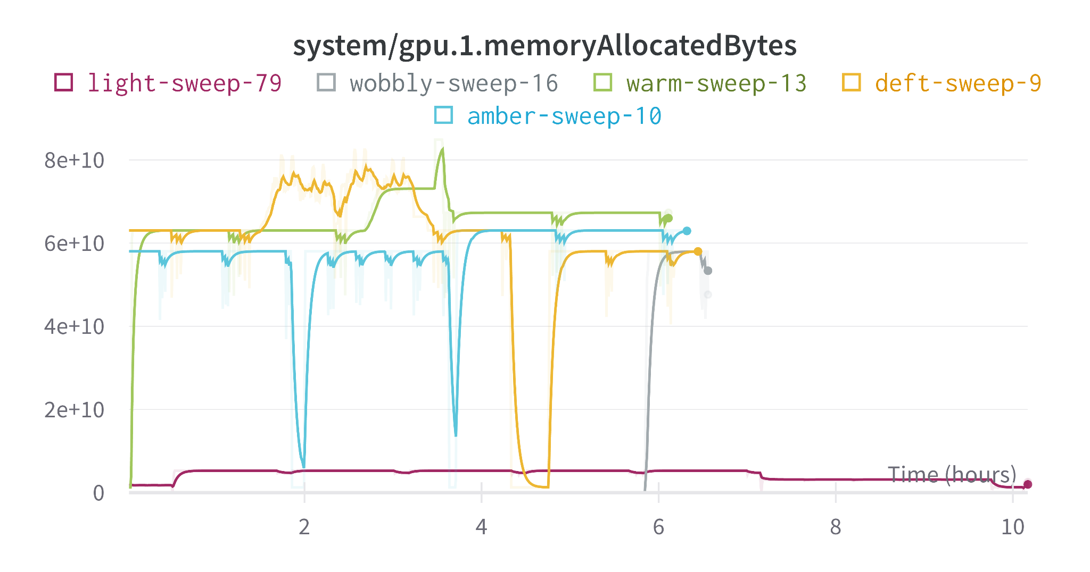
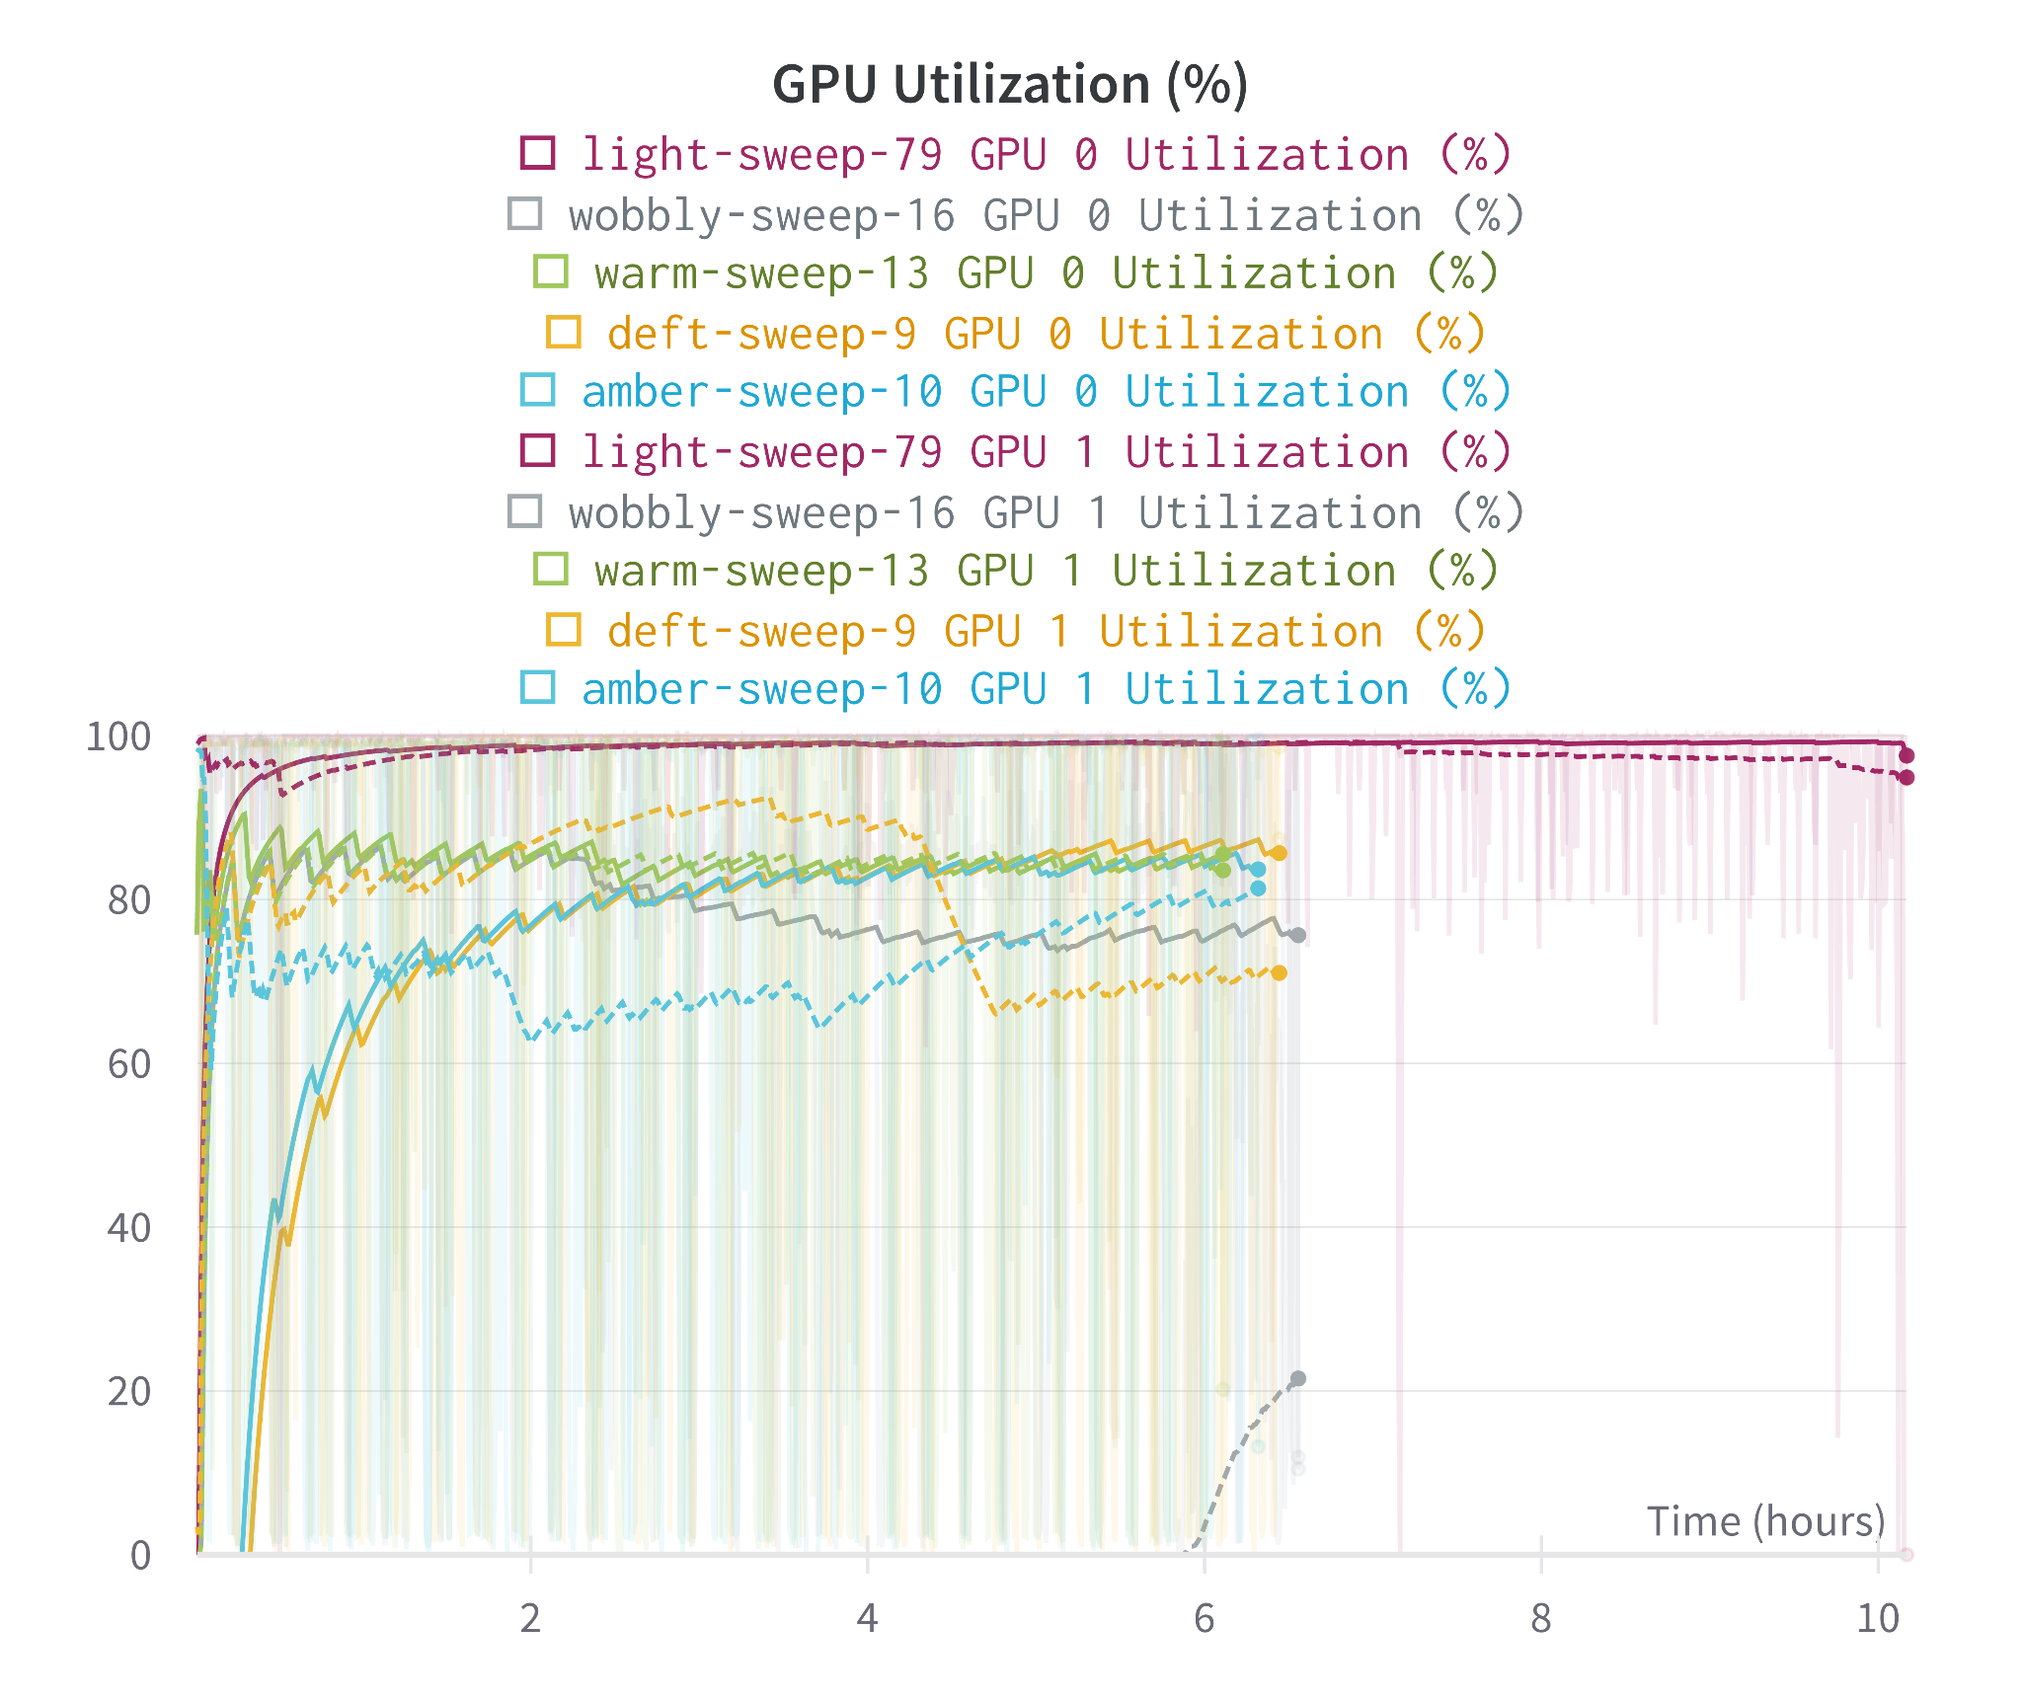
Hardware Usage Sample Overview

Slide 37
First Experiment
Discussion
Initial experiments have been conducted on different large language models with various hyperparameters on FinArg dataset.

Slide 38
Motivation

Slide 39
Conclusion
Leverage Language Learning Models for Argument Relation Detection Task

Slide 40
What I Did So Far
Fine Tuned Different LLMs on FinArg Dataset with Hyperparameter Tuning using Vanilla Transfer Learning.

Slide 41
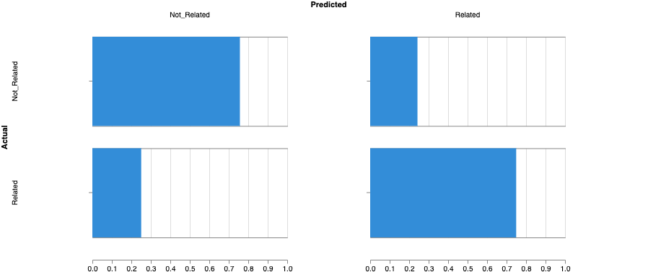
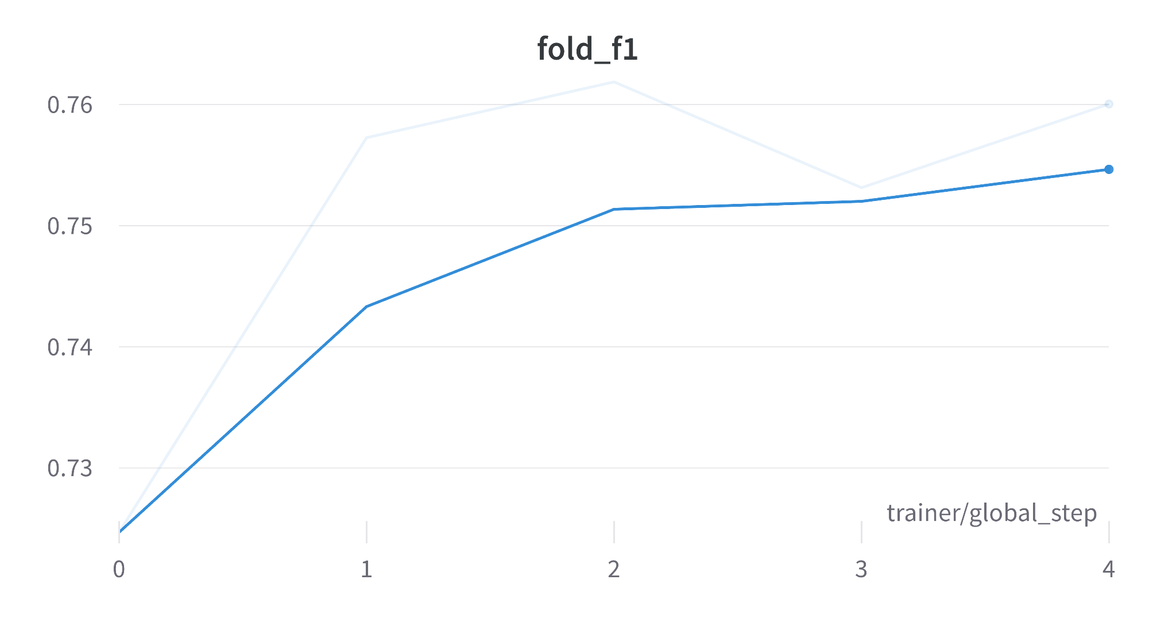
Best Run
Model: "ArgumentMining-EN-ARI-Debate"
Epochs: 5
Max Length: 256
lr: 0.00005 "mean_accuracy": 0.753 +- 0.013
"mean_f1": 0.751 +- 0.013
"mean_precision": 0.753 +- 0.013
"mean_recall": 0.753 +- 0.013
Note: there is a slight difference between different metric but can’t observe it due to 3 floating point precision.

